Slide 1
Plots of resamples
Jorge Bustamante 6/3/2022

Slide 2
Background info of workflow
100 Resamples
Red line segments = original scores
Black Boxes = Not significant

Slide 3
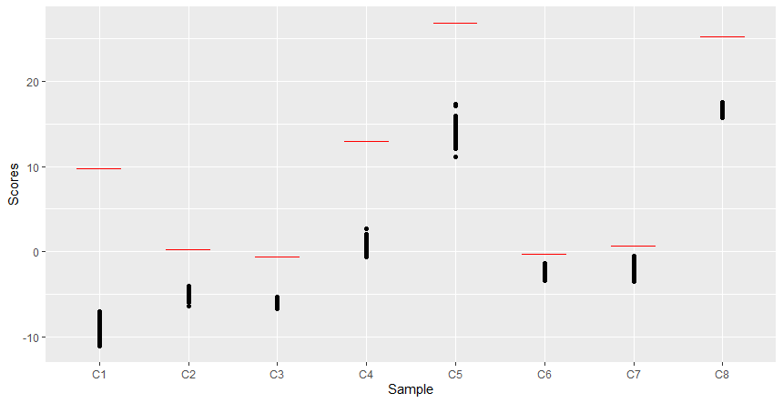
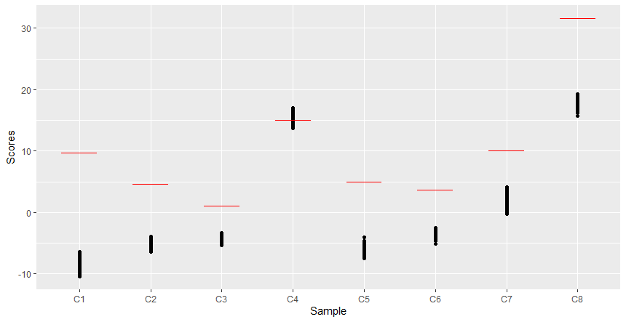
Gse152178 – Pre/Post Treatment samples
Pre-Treatment Samples – All Significant
Post-Treatment Samples
p = 0.67

Slide 4
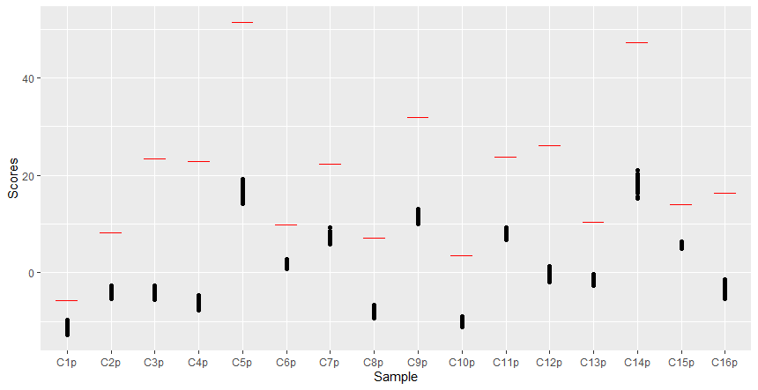
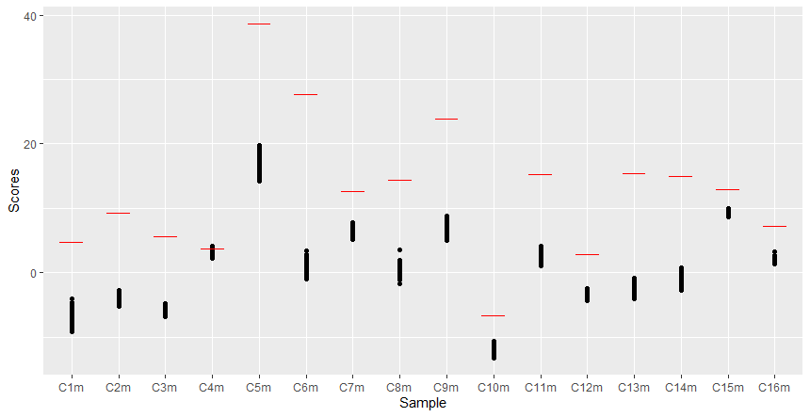
Gse100787 – Primary/Metastatic Samples
Primary Samples – All Significant
Metastatic Samples
p = 0.14

